Slide 1

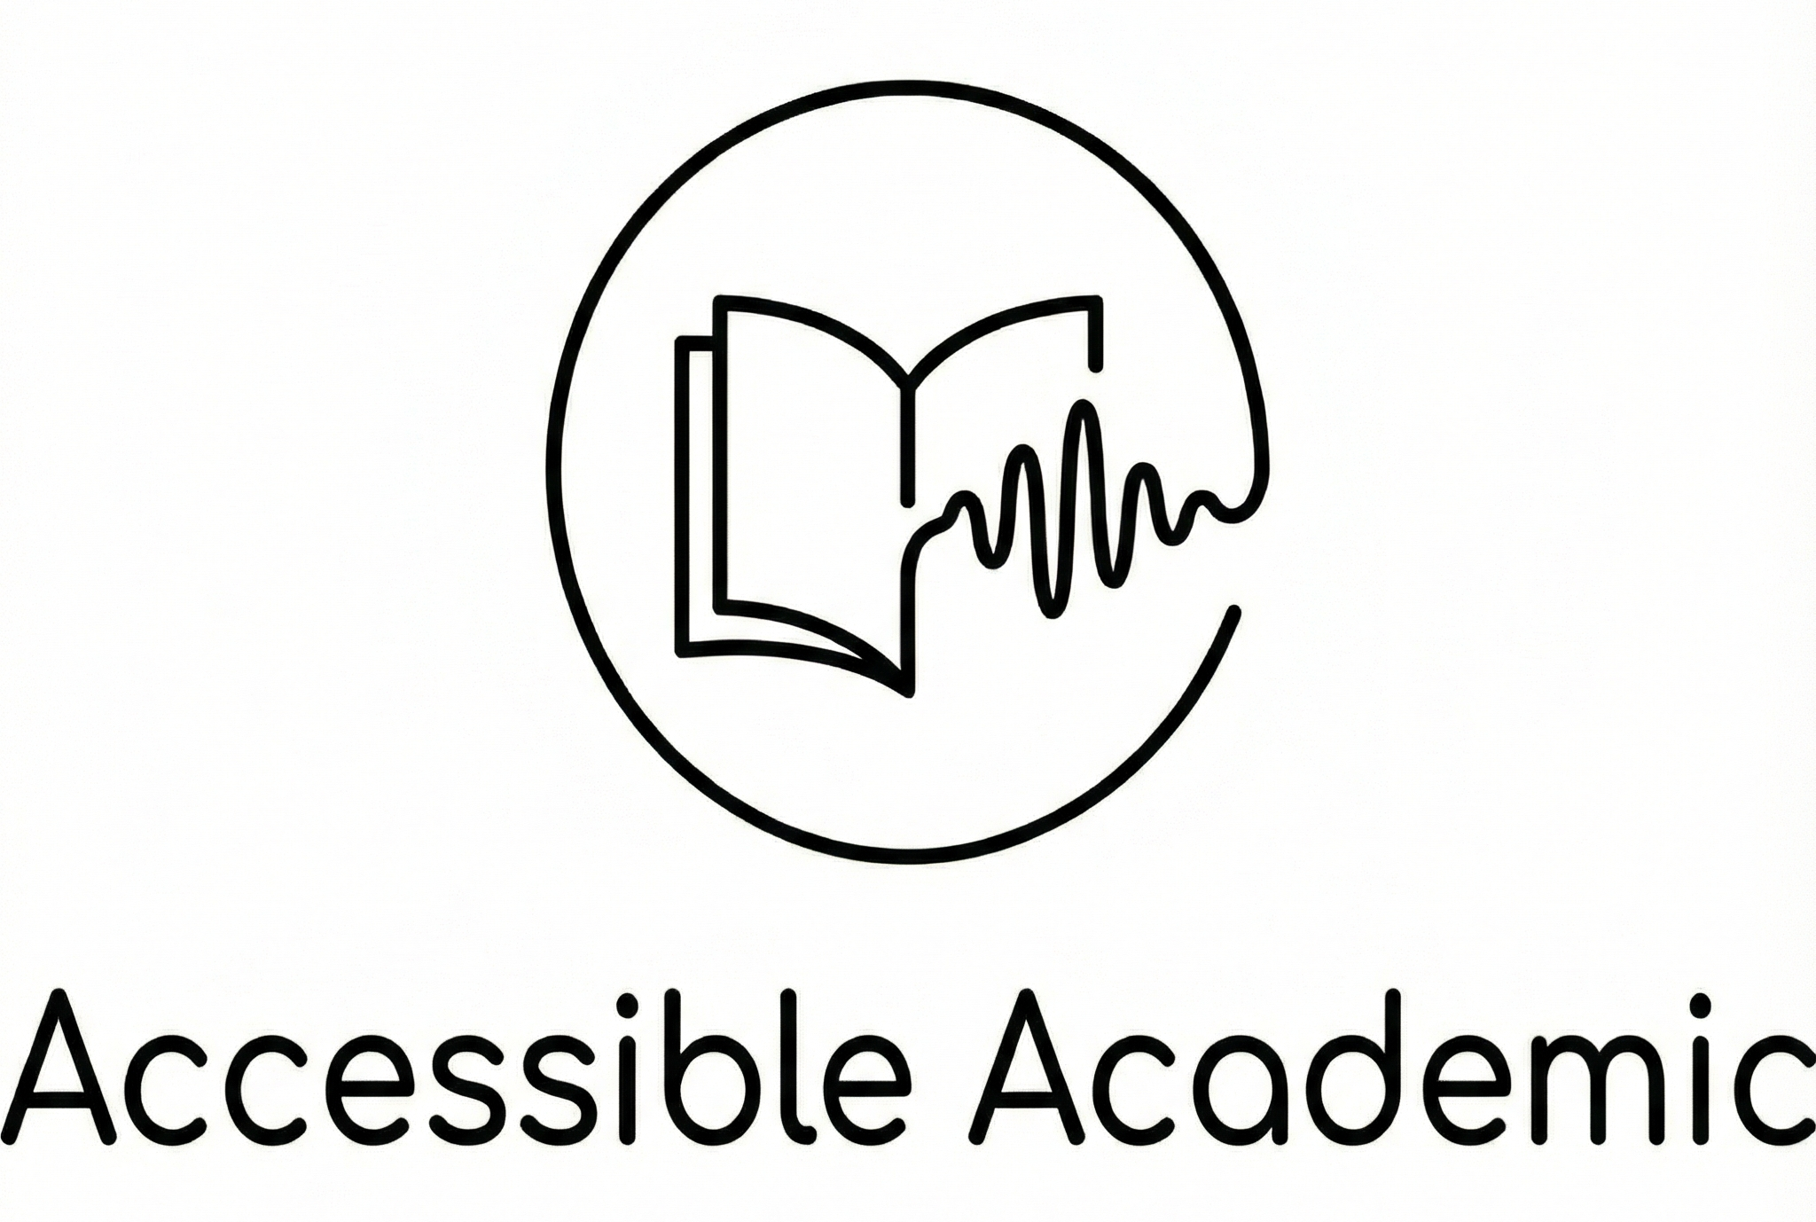
Empowering Education Through AI Accessibility
Presented by: Adi Tapiero & Matan Gurfinkel
Mentor: Dror Margalit
Project no.15002930
Entrepreneurship Workshop in Software Development 2025

Slide 2
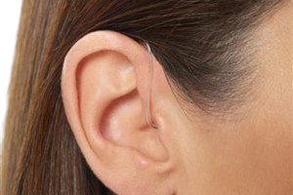
A Mission Born from Personal Struggle
Adi's Story: Hearing Impairment
"Accessibility shouldn't be a checkbox; it should be a commitment."
Adi Tapiero, faced the daily exhaustion of following muffled lecture recordings without accurate Hebrew captions. This wasn't just a technical flaw; it was a barrier to her basic right to understand.
Accessible Academic was created to ensure no student is left behind in a digital-first world.

Slide 3



Silent Barriers in Modern Education
Accessibility Gap
Students who are hard of hearing struggle with recordings lacking accurate Hebrew captions.
Poor Audio Quality
Large hall acoustics and low-quality mics make lectures muffled even for general students.
Information Overload
Massive amounts of raw video content are difficult to navigate and summarize manually.

Slide 4






Our Solution Bridges the Inclusive Gap
Audio Rescue
Accurate Hebrew STT
Smart Study Suite
Intelligent gain boosting and normalization to transform muffled hall acoustics into clear speech.
Specialized AI pipeline for Hebrew academic terminology, delivering synchronized word-level captions.
Automatic extraction of key topics, summaries, and interactive flashcards to enhance retention.

Slide 5




A Layered AI Pipeline Architecture
Audio Enhancement
FFmpeg -driven Gain Normalization
Raw Transcription
High-precision Hebrew Speech-to-Text
Logical Refinement
GPT-4o powered Academic Grade Editing
Knowledge Synthesis
Extraction of Summaries & Flashcards

Slide 6



Leveraging Best-of-Breed AI Engines
AssemblyAI
OpenAI GPT-4o
Python / FastAPI
Best-in-class Hebrew STT for high accuracy in technical academic contexts.
Advanced for understanding transcript, summarization, and interactive tools.
Robust, asynchronous backend for handling high-volume media processing.

Slide 7
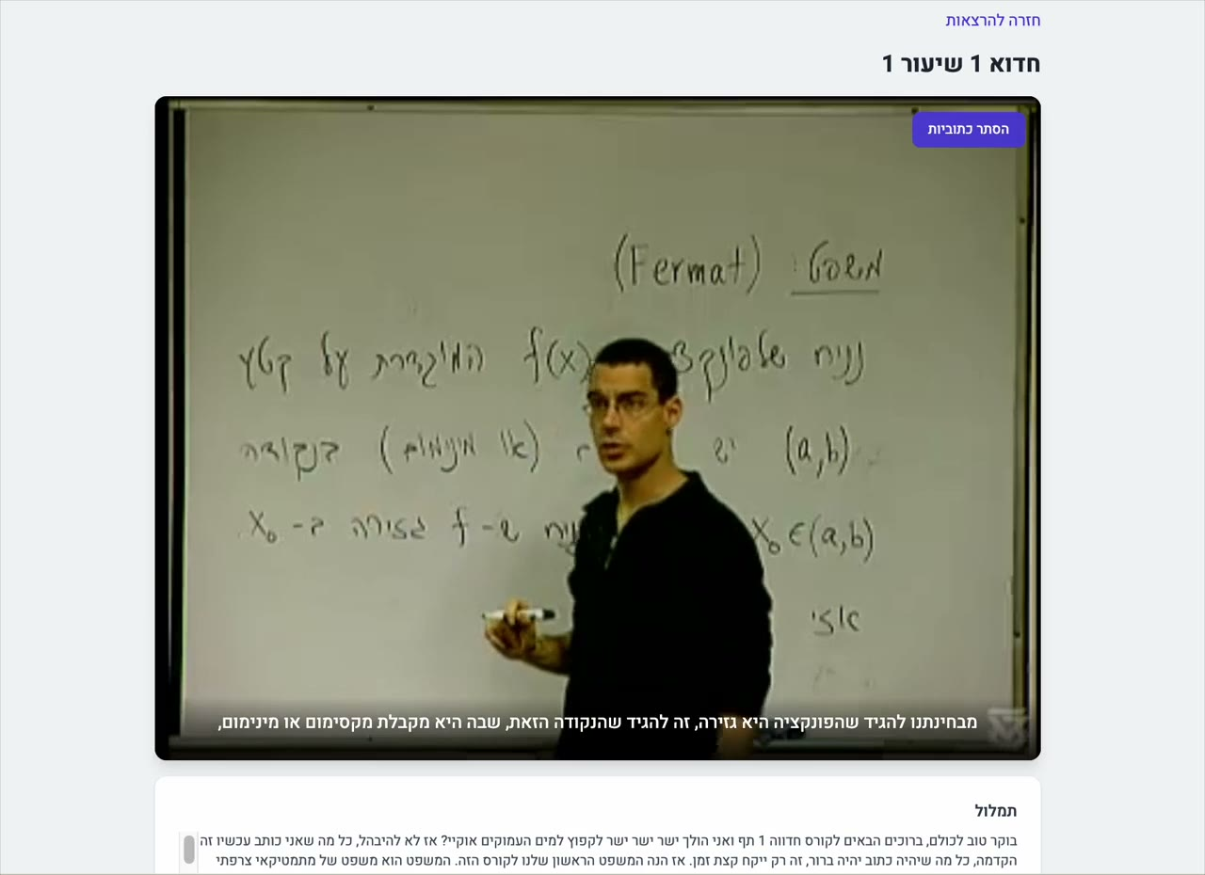

Functional MVP Delivering Real Impact
Our Pilot MVP Includes:
Full Hebrew/English UI Toggle | Show/Hide Synchronized Captions | Deep-Dive Summaries | Interactive Flashcards

Slide 8
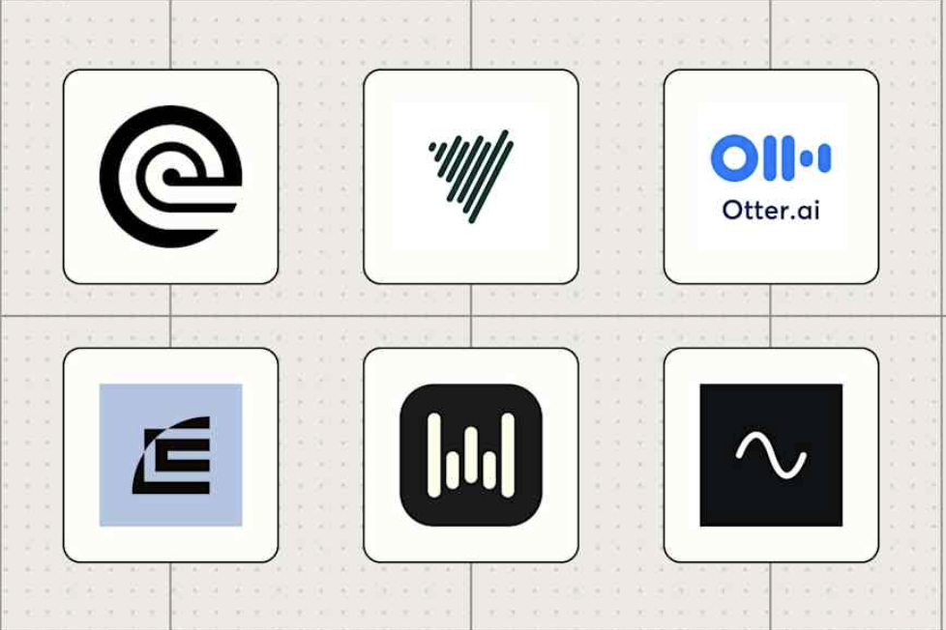

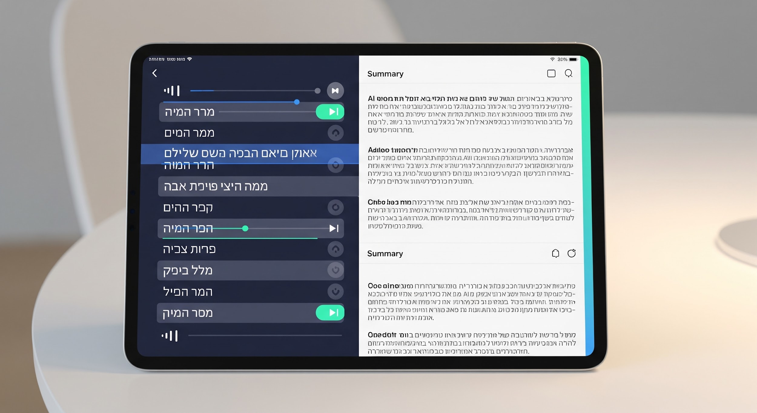
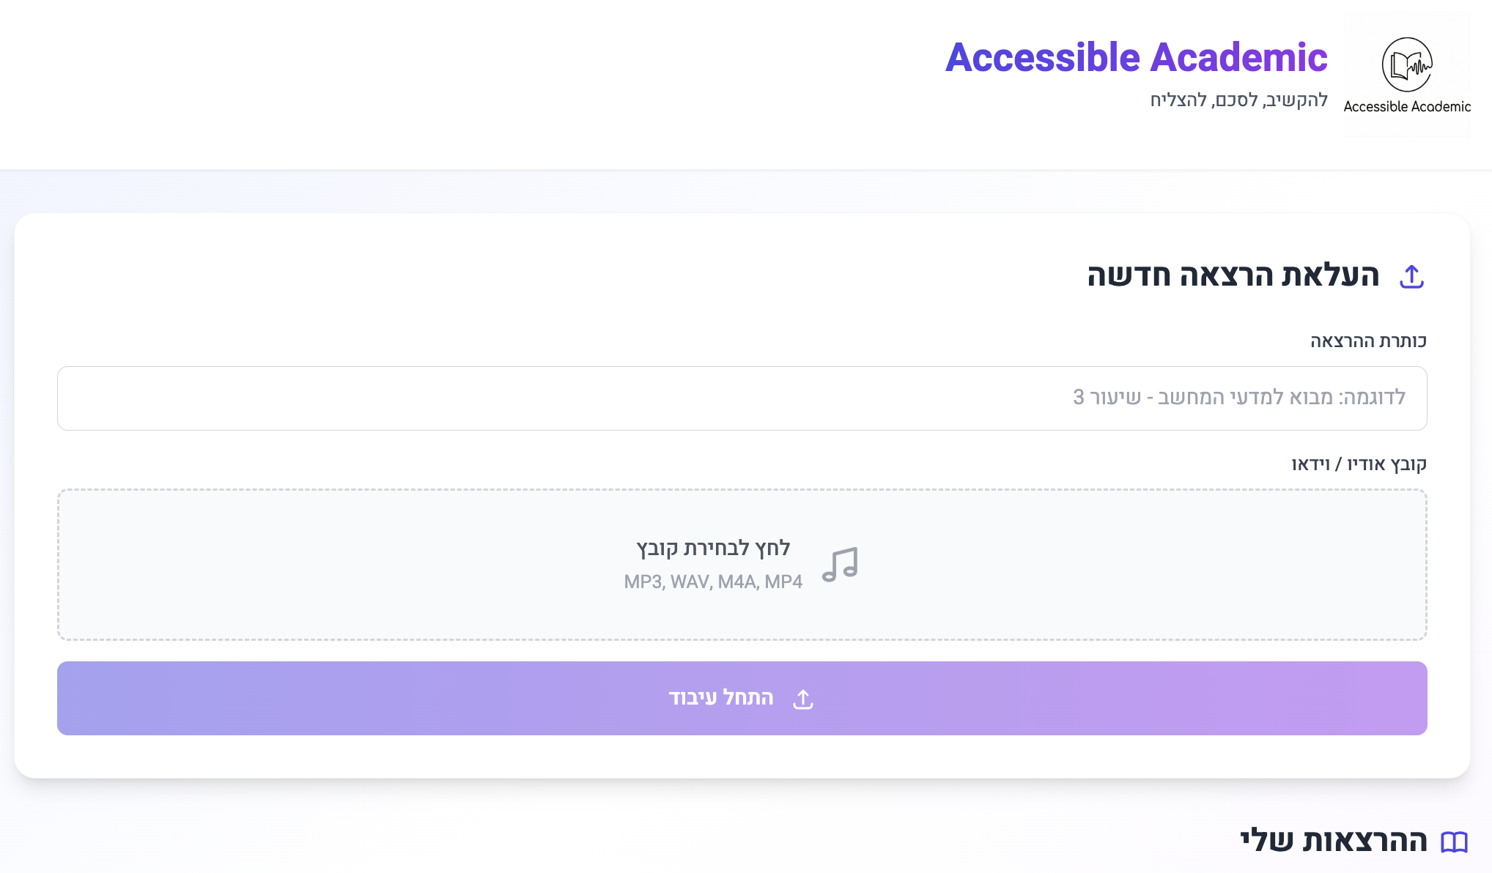
Market Landscape: Why Our Solution Stands Out
IDEAL CHOICE
Generic STT Tools
Manual Services
Accessible Academic
• Otter.ai / Zoom Transcripts and more….
• Basic accuracy in Hebrew
• No academic context
• Human transcribers
• Prohibitively expensive
• Turnaround time: 24-48h
✓ Specialized Hebrew STT
✓ Academic Terminologies
✓ Instant AI Study Materials
✓ Low-cost

Slide 9
Roadmap: From PoC to Institutional Scale
Q2 - Prototype
PoC Implementation: Full cycle from Audio to JSON Refinement.
Q4 - Scale
Current: Institutional Pilot & Final Presentation at the College Fair.
Q1 - Validation
Q3 - Integration
Tech Validation & API Testing across complex Hebrew accents.
Delivered: Panopto Integration & Institutional Automation.

Slide 10
Questions?
Building a More Inclusive Academic Future, Together.
https://github.com/adi0258/AccessibleAcademic
matangu@mta.ac.il | adita3@mta.ac.il

